Slide 1
Algorithms #1
A supplemental lesson for AP CSP
This lesson is based from a project created by Amazon Future Engineers + edhesive called “Warehouse Challenge.”

Slide 2
Warm-up
What is an algorithm?
Definition: An algorithm is a sequence of steps for completing a task.

Slide 3
Algorithms
AP CSP Big Idea #3
All programming languages use similar programming structures and commands.
Students should have a basic understanding of how these building blocks are combined to form algorithms and abstractions.
This big idea focuses on determining the efficiency of algorithms, as well as writing and implementing algorithms in a program.

Slide 4
Algorithms
From the AP CSP Curriculum and Exam Description:
Today’s lesson will give you practice in evaluating, implementing and applying algorithms using robot code.

Slide 5
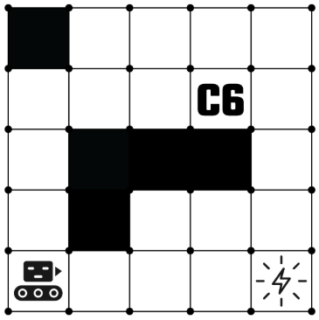
The Warehouse Map
Robots move one square at a time.
Robots move freely on white squares.
Black squares are shelves or walls, and robots cannot move there.
If a robot tries to move into a black square or the edge of the warehouse, it will crash and the program stops.
Letters and numbers on the map indicate packages to be picked up or chutes where packages are delivered.

Slide 6
Robot Code:
Robots can only follow very precise instructions.
They move or perform actions in the warehouse based on program code.
Robots follow each of the commands in the code one line at a time, in order.

Slide 7
Robot Commands:
MOVE_FORWARD()
Robot moves one square forward in the direction it is facing.
ROTATE_LEFT()
Robot rotates 90 degrees counterclockwise (robot’s left) in the square it is in.
ROTATE_RIGHT()
Robot rotates 90 degrees clockwise (robot’s right) in the square it is in.
If any of the commands have a number in parenthesis (an argument), the action is performed that many times. Otherwise, the action is performed once.

Slide 8
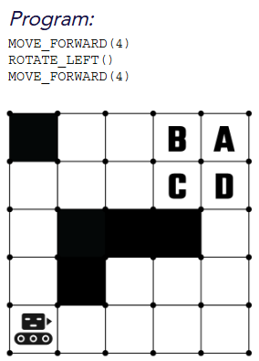
Robot Code:
Try this sample problem:
A robot is carrying a package to a delivery chute using the following program. Wherever the robot stops is the square that the chute is located. Which square is the chute located in the warehouse?
A
B
C
D

Slide 9
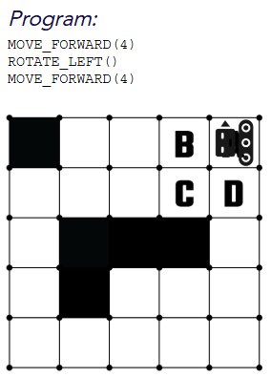
Code Solution:
Try this sample problem:
A robot is carrying a package to a delivery chute using the following program. Wherever the robot stops is the square that the chute is located. Which square is the chute located in the warehouse?
A
B
C
D

Slide 10
The order is in!
Now, get ready to start!
Can you help these robots navigate the busy warehouse, avoid obstacles, and get the package delivered on time?
Complete the problems on your activity guide.

